Slide 1
Transport, Continuity Equations and Simulation
Diffusion, Drift and FD

Slide 2
Outline
Introduction to transport
Diffusion
Drift
Continuity
Semiconductor transport equations
Non-linearity
Coupling
Complexity
Finite Difference Formulation
Examples
Gaussian pulses
PN diodes

Slide 3
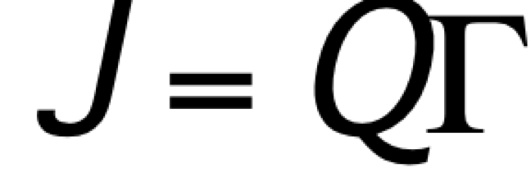
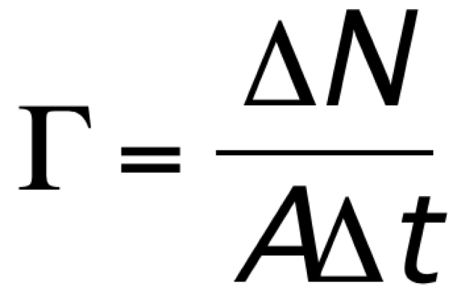
Definition of Particle Flux
Total Carrier Transport
Particle flux/transport due to:
Diffusion: Ficks first law, gradient drives flux, ~diffusivity
Drift: Electric field drives flux (~E ~n) – we have used mobility to characterize this.
Sum both electrons and holes for complete flux
Einstein relations link mobility and diffusivity
Two mechanisms two carriers produce complex flows
Diffusion from high concentration to low
Steady-state no flow present
Presence of an impurity profile produces a built in field.
In SS this implies an opposing field to balance the diffusion
Γ = particle flux, ΔN = number of particles crossing A in a time interval Δt, A = area, Δt = time interval
Definition of Current Density
J = electric current density, Q = charge of the particle, Γ = particle flux

Slide 4
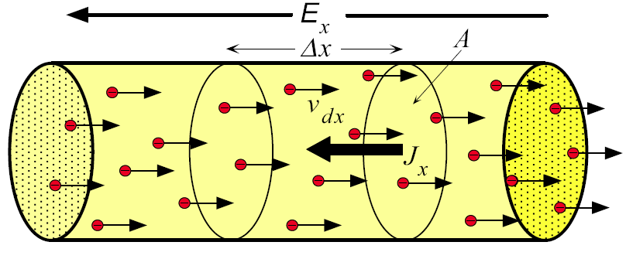
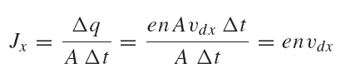
Definition of current density
A current is a flow of charge through an area in a net amount of time.
We will often use current density J not I where:
I = J X Area.
Subtleties lie in v_{dx}
Drift of electrons in a conductor in the presence of an applied electric field. Electrons drift with an average velocity v_{dx} in the x-direction. (E_{x} is the electric field.)

Slide 5
Definition of Drift Velocity
v_{dx} = drift velocity in x direction, N = number of conduction electrons, v_{xi} = x direction velocity of ith electron
We define a drift velocity v_{d} of an electron gas as the average velocity of all the electrons (usually in one direction – the direction of the applied electric field).
Generally we think of this drift as due to an applied E field

Slide 6
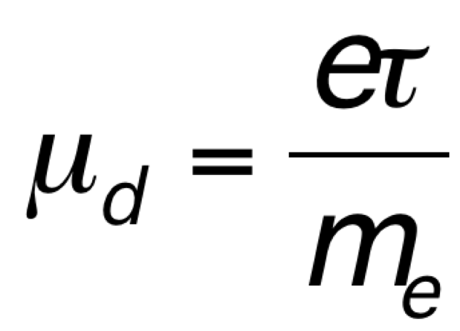
Current Density and Drift Velocity
J_{x} (t) = env_{dx}(t)
This allows for a definition of the current density
Drift Currents – Ohms law in point form
Define a mobility μ where:
v_{dx} = μ_{d}E_{x}
And we have both electrons and holes so:

Slide 7
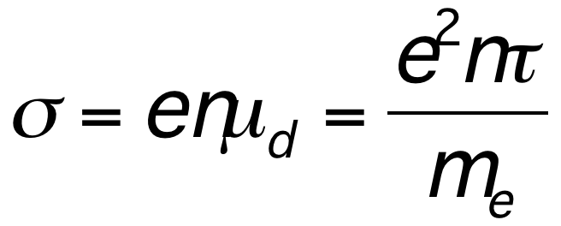
Conductivity
σ = conductivity, e = electronic charge, n = number of electrons per unit volume, μ_{d} = drift velocity, τ = mean scattering (collision) time = relaxation time, m_{e} = mass of an electron in free space.
If we know the number of electrons we can define a conductivity. Which gives J = σ E
We also use resistivity which is:

Slide 8
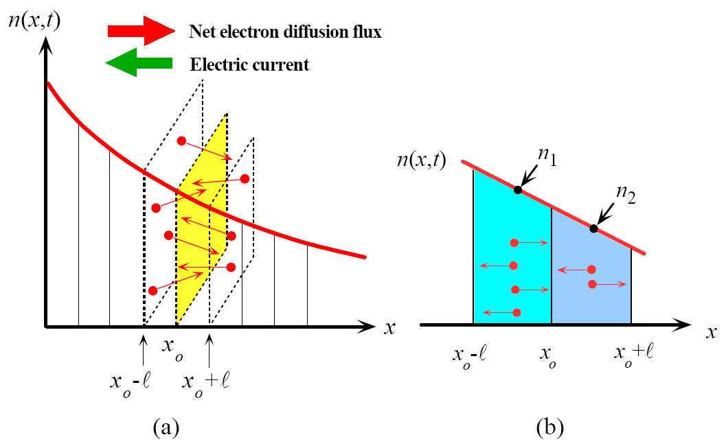
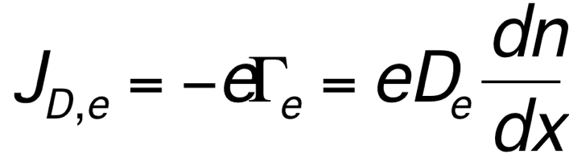
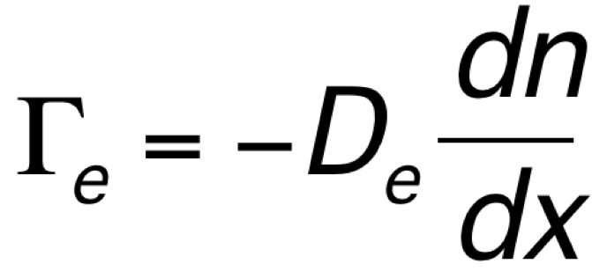
Diffusion
(a) Arbitrary electron concentration n (x, t) profile in a semiconductor. There is a net diffusion
(flux) of electrons from higher to lower concentrations.
(b) Expanded view of two adjacent sections at x₀. There are more electrons crossing x₀ coming
From the left (x₀-) than coming from the right (x₀+)
Fick’s First Law
Electron Diffusion Current Density

Slide 9
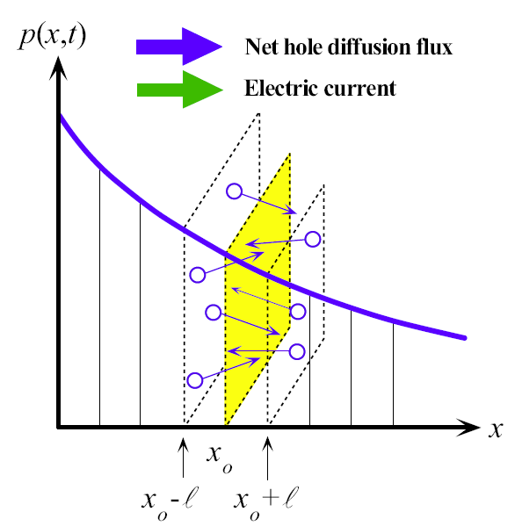
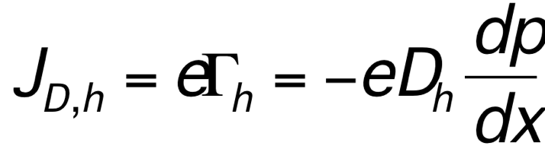
Hole Diffusion Current Density
J_{D, h} = electric current density due to hole diffusion, e = electronic charge, Γ_{h} = hole flux, D_{h} = diffusion coefficient of holes, dp/dx = hole concentration gradient
Arbitrary hole concentration p (x, t) profile in a semiconductor.
There is a net diffusion (flux) of holes from higher to lower concentrations. There are more
holes crossing x₀ coming from the left (x₀-) than coming from the right (x₀+).

Slide 10
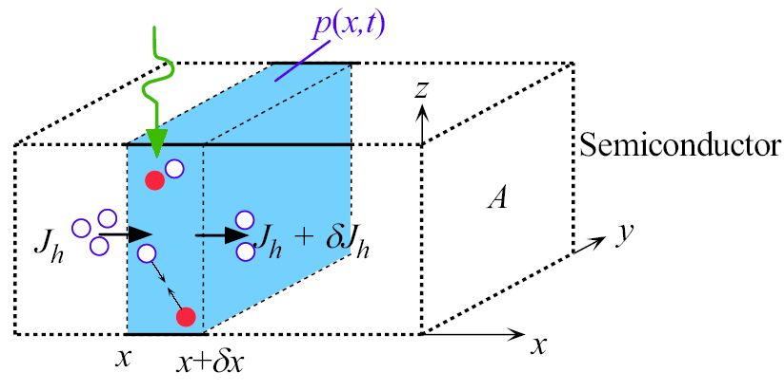
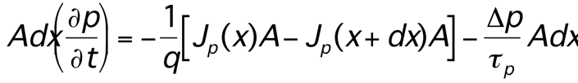
Derivation of Continuity Equation -- accounting equation (conservation of mass
To solve for the time dependent n and p we need a differential equation that links flow to recombination and generation.
Full equation – derived a partial differential equation
Divergence of the current flow must equal the net R/G
Use simple life time for R/G from equilibrium value.
Consider carrier-flux into/out-of an infinitesimal volume:

Slide 11
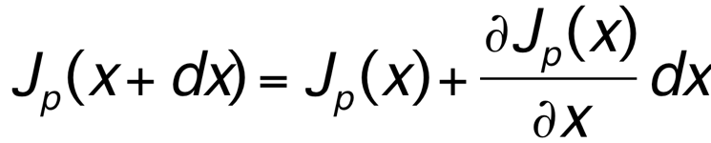
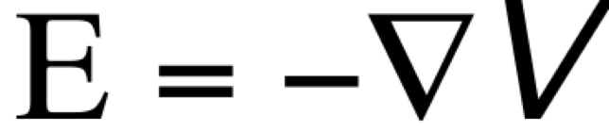
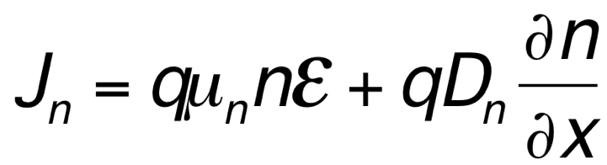
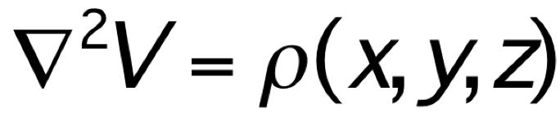
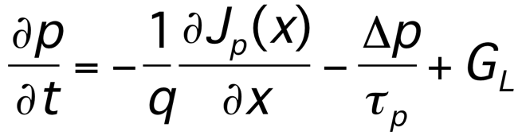
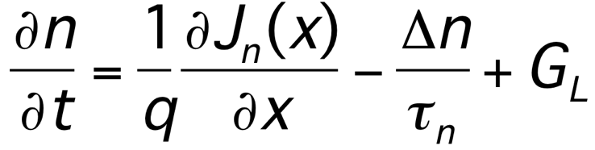
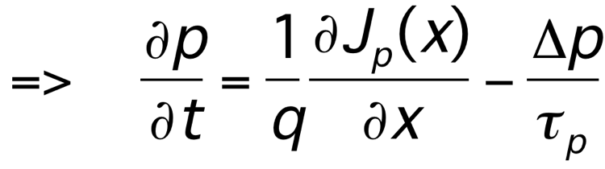
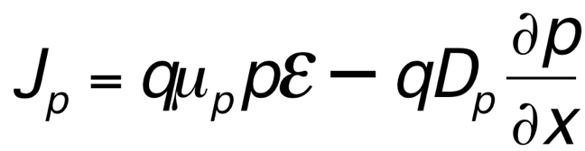
Continuity
Equations:
Drift and diffusion
With
And

Slide 12
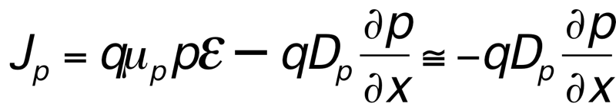
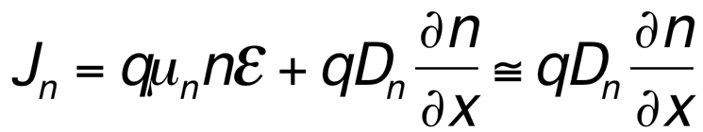
Derivation of Minority Carrier Diffusion Equations
The minority carrier diffusion equations are derived from the general continuity equations, and are applicable only for minority carriers.
Simplifying assumptions:
1. The electric field is small, such that
in p-type material
in n-type material
2. n₀ and p₀ are independent of x (i.e. uniform doping)
3. low-level injection conditions prevail

Slide 13
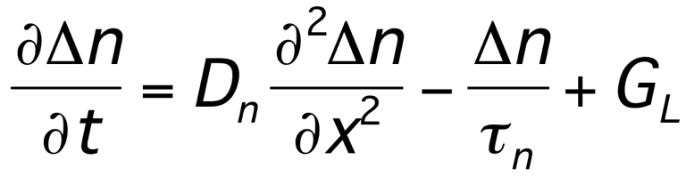
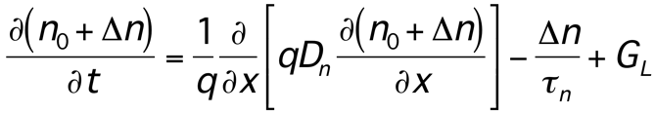
Starting with the continuity equation for electrons ( and defining n = n₀ + Δn where Δn is called the excess carriers and n₀ is the equilibrium value:

Slide 14
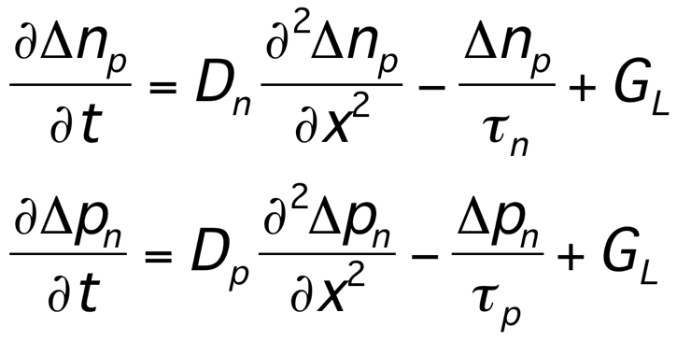
Carrier Concentration Notation
The subscript “n” or “p” is used to explicitly denote n-type or p-type material, e.g.
p_{n} is the hole (minority-carrier) concentration in n-type mat’l
n_{p} is the electron (minority-carrier) concentration in n-type mat’l
Thus the minority carrier diffusion equations are

Slide 15
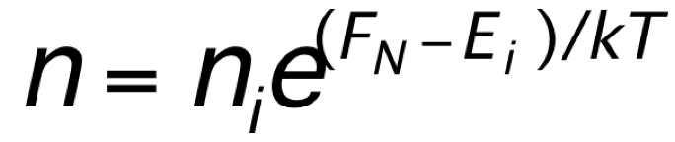
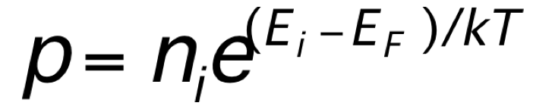
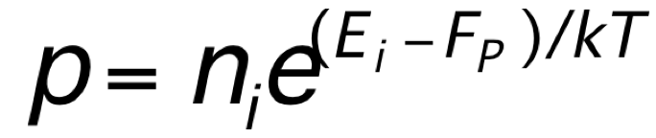
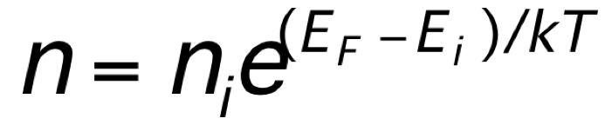
Quasi-Fermi Levels
Whenever Δn = Δp ≠ 0, np ≠ n_{i}². However, we would like to preserve and use the relations:
These equations imply np = n_{i}², however. The solution is to introduce two quasi-Fermi levels F_{N} and F_{P} such that

Slide 16
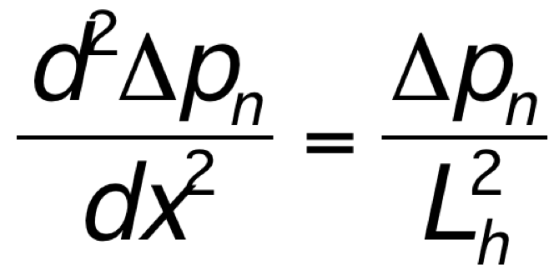
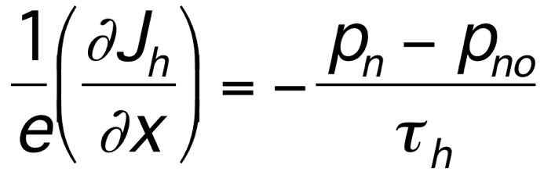
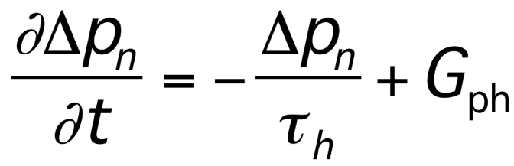
Steady-State Continuity Equation for Holes
Special Cases
Continuity Equation with Uniform Photogeneration and no divergence of current
Steady-State Continuity Equation with E = 0
Very often we can use simplified cases.
Δp_{n} = p_{n} − p_{no} is the excess hole concentration
From Principles of Electronic Materials and Devices, Third Edition, S.O. Kasap (© McGraw-Hill, 2005)

Slide 17
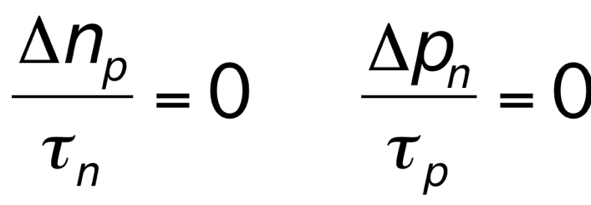
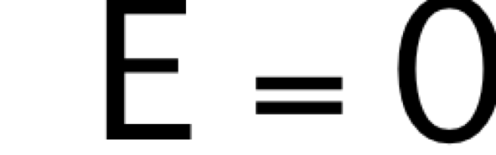
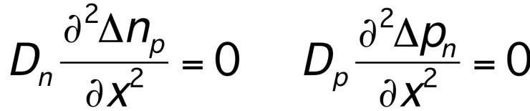
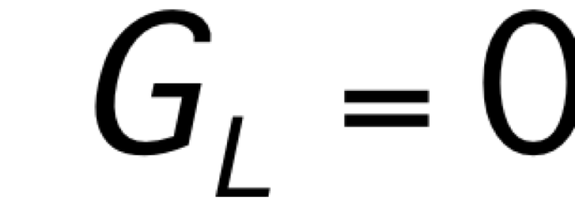
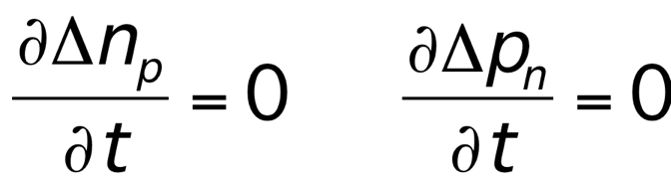
Simplifications (Special Cases)
Steady state:
No diffusion current:
No R-G:
No light:
No E field:

Slide 18
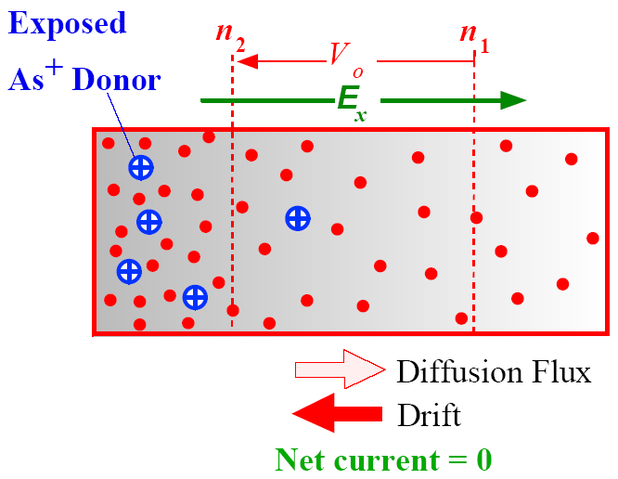
Complexity - Built in Field
Simple problem in the book solve for a 1D rod of material (open circuit configuration)
Assume N(x) = N₀ e^{-x/b}
Assume Steady-State
Set the total electron flow to zero
Non-uniform doping profile results in electron diffusion toward the less concentrated regions.
This exposes positively charged donors and sets up a built-in field E_{x}. In the steady state, the
diffusion of electrons toward the right is balanced by their drift toward the left.

Slide 19
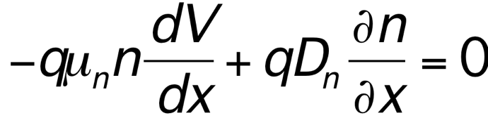
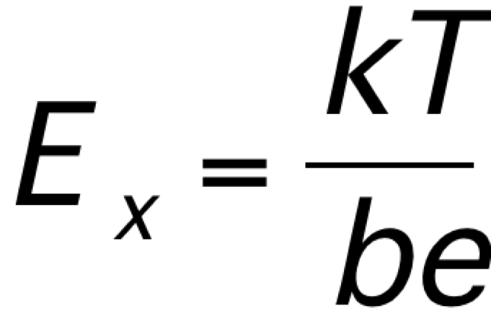
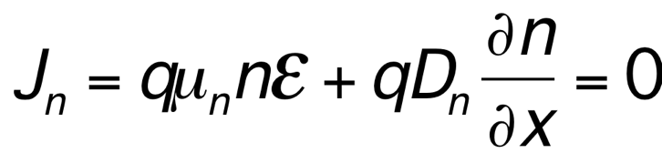
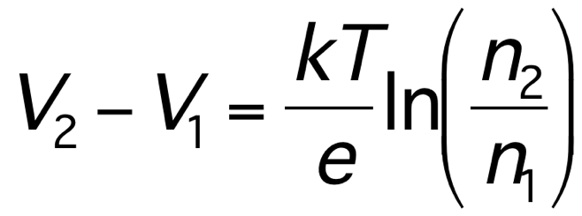
SS electron flow = 0
E is gradient of potential
Integrate the equation between limits gives built in field
Assume the N(x) is not disturbed significantly n₂ and n₁ are prescribed by doping. V₂ and V₁ are voltages at any points 1 and 2.
Use Einstein relation to simplify with
E = grad V
n ~ N(x)
Result is built in constant electric field
We can use this in the base of transistor to accelerate the electrons to the collector and increase the “speed” of the device.

Slide 20
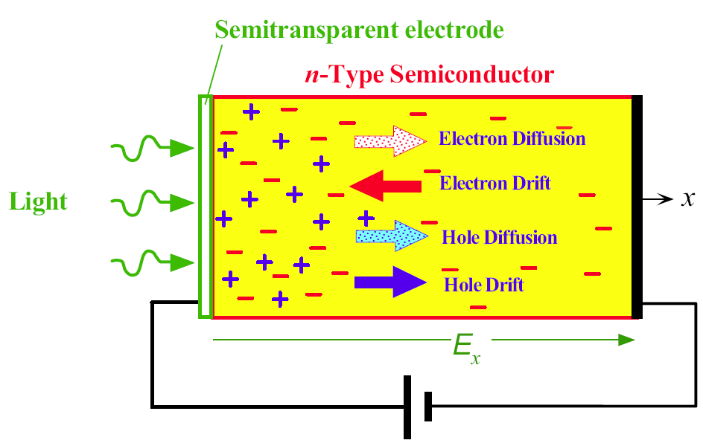
Photo-generation on Edge at Steady-State
1D drift-diffusion equation
Two carriers and two transport mechanisms.
Life gets a bit complicated.
Total Electron Current Due to Drift and Diffusion
Total Hole Current Due to Drift and Diffusion
Einstein Relation

Slide 21
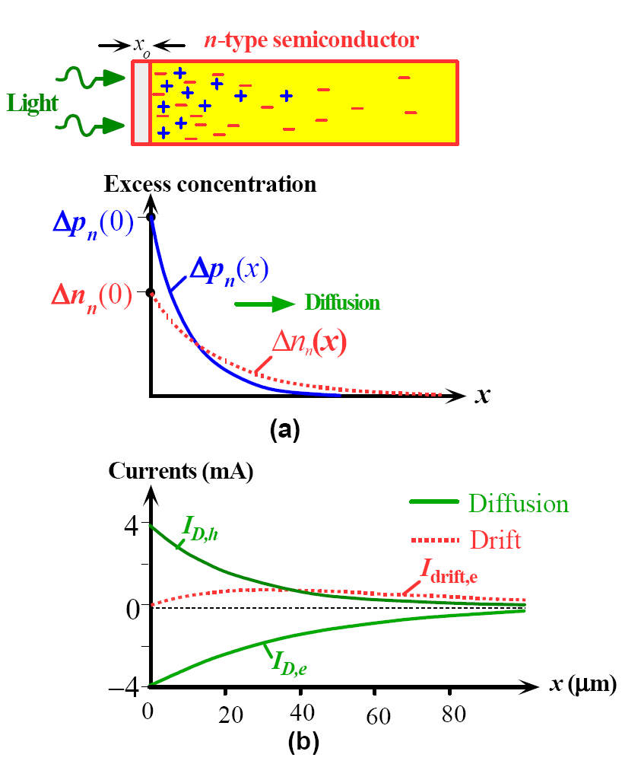
Diffusion equation for both carriers
Steady-state – flow of created electrons and holes at x=0 must be equal.
Generation at the edge – diffusion away with recombination occurring
Weak injection – majority carrier concentration is undisturbed
Different diffusivities/mobilities result in different distributions.
Two currents flow and tend to cancel out, but don’t quite.
As total current is zero there must be a drift current.
Drift current is due to majority carriers.
Minority carrier injection! -- is what we call this set of assumptions
(a) Steady state excess carrier concentration profiles in
an n-type semiconductor that is continuously illuminated
at one end.
(b) Majority and minority carrier current components in
open circuit.
Total current is zero.

Slide 22
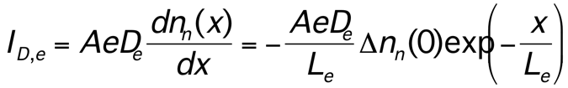
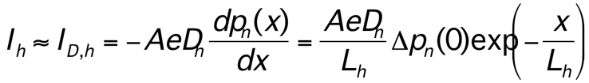
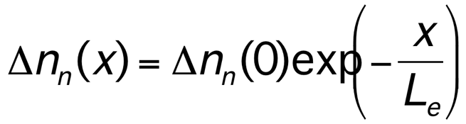
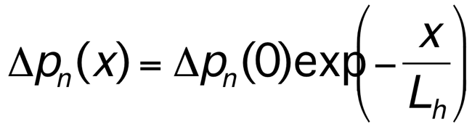
Derivation - Kasop
Assumption of diffusion only for minority carriers. Small field and few carriers mean insignificant drift current.
Presence of recombination gives a drop in the current (exp) as we move away from the surface.
Likewise, electrons also generated at surface diffuse away and we can solve the diffusion current for electrons.
Note this is only the current determined by diffusion – not the total electron current.
gives

Slide 23
Electron Drift Current: Use the Open Circuit Condition
Now in steady-state the total current must be zero.
But the two diffusion currents are different due to D_{h} != D_{e}
And we can have a significant drift current for majority carriers (electrons) at a small field due large number of carriers.
So we can calculate the drift current that accommodates the difference in diffusion currents.
Drift is almost entirely majority carrier effect.
Difference in diffusion currents due to different effective masses and scattering.
Need to check that ρ = n – p that generates the E field is small and that low-level injection holds.
gives

Slide 24
Numerical Modeling of drift-diffusion
Any real problem
Transient
Complex geometry or doping
Is too difficult for analytical approaches
Numerical modeling is extensively used
Coupled Potential, n and p equations or perhaps E_{fn} and E_{fp}
Finite difference or FEM
For good results need very fine mesh which makes simulation very slow
Non-uniform meshing is essential due to non-linear nature of equations and doping profiles.
Example of 1D FD for SS and Transient.

Slide 25
Numerical modeling of transport – finite difference
Numerical Approach
Initial Guess for carrier density
No
Solve Poisson’s Equation
Yes
Solve Transport Equations
Converge! Or done
Regardless how we start, all equations must be self-consistently satisfied at the same time
Notes:
NEMO can provide the modeling essential for accelerating the development of nanoelectronics.
The physical model begins at the atomic level with the atomic orbitals. Efficient numerical algorithms allow NEMO to model practical semiconductor devices of several thousand atomic layers. NEMO includes the effect of open contacts, lattice vibration, alloy disorder and interface roughness to calculate macroscopic quantities such as the electron and hole density and the current.
The computational algorithms are accessed by a flexible graphical user interface (GUI) for rapid design prototyping and analysis. The figure at the right consists of screen dumps from the GUI chosen to illustrate its versatility.
The 3 figures in the upper right show
the band profile of of an ultra-scaled MOS device with
the electron charge calculated both semi-classically and quantum mechanically and
the calculated and experimental tunnel current for different SiO₂ barrier thicknesses.
The two figures in the lower right display
the band profile of an optoelectronic switch and
the calculated quantum states of the device. The comparison of the experimental and calculated current for this device is shown in the lower right quadrant of the following slide.

Slide 26
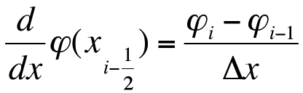



“Straight-forward” Method of Solving Transport Equations
In order to solve this equation, we first need to find a linear approximation to turn the differential equation into a discretized linear equation.
First step is to use the mesh point variables to interpolate the midpoint variables
Notes:
NEMO can provide the modeling essential for accelerating the development of nanoelectronics.
The physical model begins at the atomic level with the atomic orbitals. Efficient numerical algorithms allow NEMO to model practical semiconductor devices of several thousand atomic layers. NEMO includes the effect of open contacts, lattice vibration, alloy disorder and interface roughness to calculate macroscopic quantities such as the electron and hole density and the current.
The computational algorithms are accessed by a flexible graphical user interface (GUI) for rapid design prototyping and analysis. The figure at the right consists of screen dumps from the GUI chosen to illustrate its versatility.
The 3 figures in the upper right show
the band profile of of an ultra-scaled MOS device with
the electron charge calculated both semi-classically and quantum mechanically and
the calculated and experimental tunnel current for different SiO₂ barrier thicknesses.
The two figures in the lower right display
the band profile of an optoelectronic switch and
the calculated quantum states of the device. The comparison of the experimental and calculated current for this device is shown in the lower right quadrant of the following slide.

Slide 27


“Straight-forward” Method of Solving Transport Equations
Solving the Transport Equations
Substitute the approximated variables back to transport equations
E = grad(V)
dn/dx
Continuity Equation tells us for steady-state (G_{n} = 0): J_{n,i+1/2} = J_{n,i-1/2}
J_{i-1/2}
J_{i+1/2}
Continuity Equation tells us for Transient (G_{n} = 0):
n^{j}_{i} = n_{i}^{j-1} + Δt div(J_{n,i}^{j-1} ) = n_{i}^{j-1} + Δt (J_{n,i+1/2}^{j-1} - J_{n,i-1/2}^{j-1} )/Δx
Notes:
NEMO can provide the modeling essential for accelerating the development of nanoelectronics.
The physical model begins at the atomic level with the atomic orbitals. Efficient numerical algorithms allow NEMO to model practical semiconductor devices of several thousand atomic layers. NEMO includes the effect of open contacts, lattice vibration, alloy disorder and interface roughness to calculate macroscopic quantities such as the electron and hole density and the current.
The computational algorithms are accessed by a flexible graphical user interface (GUI) for rapid design prototyping and analysis. The figure at the right consists of screen dumps from the GUI chosen to illustrate its versatility.
The 3 figures in the upper right show
the band profile of of an ultra-scaled MOS device with
the electron charge calculated both semi-classically and quantum mechanically and
the calculated and experimental tunnel current for different SiO₂ barrier thicknesses.
The two figures in the lower right display
the band profile of an optoelectronic switch and
the calculated quantum states of the device. The comparison of the experimental and calculated current for this device is shown in the lower right quadrant of the following slide.

Slide 28

Code: Initial Setup
Choose Simulation run and run parameter file.
Create G matrix for Poisson eq. (V = G⁻¹ρ) – use L, U formulation as it’s static.
Calculate μ and D
Initialize carrier densities from doping
Calculate net ρ from doping and carrier densities

Slide 29

Code: Sim. Paras
Typical parameter file
Set simulation parameters
Coupled (V and n, p are coupled)
TwoCarriers – n and p or just n
RC – recombination on/off
Set length and number of points
Add disturbance if wanted (Gaussian)
Set BC for V
Set stopping criteria
Set up plotting stuff

Slide 30

Code: Poisson Eq
Set up G matrix for:
V = G⁻¹ ρ
Simple 1D finite difference
Bv vector used for boundary conditions
Floating
Fixed
Sparse for speed and memory

Slide 31

Code: Main flow
Find initial V and E = dV/dx
Courant-Friedrichs-Lewy time step criteria
Get max Δt for diffusion:
Δt < Δx²/D_{n,p}
Get max Δt for drift:
Δt < 2Δx/μE
Set up n and p
Two step simulation sometimes used – second simulation has new V BCs
SimulateFlow is the main loop

Slide 32

Code: Main Loop
Reset dt if need
Loop to Tstop
Δt is set by CFL criteria (non-uniform time stepping)
Basic loop:
First get V and E
Next get divJn and divJp and update n and p
Explicit for n and p
Implicit for V
If RC remove recombination Δn = Δp
Recalculate ρ
Back we go
Get V from rho
Get div(n) and update n
Get div(p) and update p
Calculate Recom. and update n and p
Add n and p to background doping to get rho

Slide 33

Code: Jn divergence
Divergence of carriers uses J at halfway points
Use average μ and D
BC are either
Zero flow (BC = 0)
Fixed n or p at equilibrium (initial values) and divergence is zero.

Slide 34


Single Carrier Gaussian packet
VbcL = VbcR = 0 so E ~ 0
Electrons diffuse out.
J_{n} = 0 at edges.
Charge biases bulk negative
V = 0 at Edges cause a mirror image
Final

Slide 35


Single Carrier Gaussian packet
VbcL = 1 VbcR = 0.
Electrons diffuse out and drift left
J_{n} = 0 at edges.
Charge accumulates on left side
Should self-limit when drift = diffusion
Final

Slide 36


Two Carriers Gaussian packet
VbcL = VbcR = 0 so E ~ 0
Electrons and holes diffuse out.
D_{n} != D_{p} so ρ is generated
No flow BC for carriers.
No net charge so no bias
Holes and electrons diffuse together! Holes slow electrons down
Recombination eliminates non-equilibrium charge
Final

Slide 37


Two Carriers Gaussian packet
VbcL = 0 VbcR = 1
Electrons/holes diffuse out and drift to opposite sides
J_{n} = 0 at edges so accumulation
No net charge
Very slow movement to equilibrium
Final

Slide 38


Exponential doping two carriers
VbcL = floating VbcR = 0
Self bias
No net charge
Very slow movement to equilibrium
Final

Slide 39
Bookmark

Slide 40

Example: PN Diode
The simplest semiconductor device is the PN diode.
We can view this as an initial diffusion of carriers both ways exposing ionized donors until large drift currents are established cancelling off the diffusion currents.
This requires a depleted region to form producing an electric field that creates the counter flowing drift current.

Slide 41


As with the Schotkky contact at equilibrium E_{F} must be constant.
Built-in voltage V_{o} aligns the fermi energies.
(a) Two isolated p and n-type semiconductors (same material).
(b) A pn junction band diagram when the two semiconductors are in contact. The Fermi level
must be uniform in equilibrium. The metallurgical junction is at M. The region around M
contains the space charge layer (SCL). On the n-side of M, SCL has the exposed positively
charged donors whereas on the p-side it has the exposed negatively charged acceptors.

Slide 42

PN junction electrostatics – depletion approximation
The depletion approximation is analytical model assuming complete depletion of the interface region. This allows the electrostatics to be calculated for simple doping profiles.

Slide 43
Biasing the Diode: Forward bias lowers the barrier to carrier flow
Energy band diagrams for a pn junction under
(a) open circuit and (b) forward bias. Note the displacement of the quasi-fermi levels.

Slide 44

Forward biased pn junction and the injection of minority carriers.
n_{p}(0) is the electron concentration just outside the depletion region on the p-side
p_{n}(0) is the hole concentration just outside the depletion region on the n-side
If we assume low-level injection we can relate the carrier densities (under bias) at the depletion edges assuming thermionic excitation
“The Law of the Junction”
Forward biased pn junction and the injection of minority carriers.
Carrier concentration profiles across the device under forward bias.
The hole potential energy with and without an applied bias. W is the width of the SCL with forward bias.

Slide 45
The injection of carriers across the depletion region will (forward bias) raise the minority carriers.
They will then diffuse across the neutral regions to the contacts forming hole and electron currents
These currents can be summed to find the total current as function of bias.
For long neutral regions the shape of the minority carrier distribution will be exponential due to recombination.
Away from the junction majority carrier drift current will carry part of the total current.
The total current anywhere in the device is constant. Just outside the depletion region it is
due to the diffusion of minority carriers.

Slide 46
Forward Bias: Diffusion Current
Hole diffusion current in n-side in the neutral region
The total current is assumed to be the sum of the diffusion currents at the two edges of the depletion region.
Where it assumed that drift current is small.
This leads to the ideal diode equation.
There is a similar expression for the electron diffusion current density J_{D,elec} in the p-region.
Ideal diode (Shockley) equation
Reverse saturation current

Slide 47

Short Diode
The geometry of the diode changes the expression for J₀
For a short neutral region recombination can be ignored and the distribution is linear.
where l_{n} and l_{p} represent the lengths of the neutral n- and p-regions outside the depletion region.
Minority carrier injection and diffusion in a short diode.

Slide 48

Model ignores a number of effects.
For a forward biased pn junction we have injection of excess carriers and their recombination in the SCL which produces a second current component.
Forward Bias
Recombination Current
Total diode current = diffusion + recombination
The diode equation

Slide 49
Reverse bias increases the barrier height and depletion width and we use the same analysis. However, we also get significant thermal generation in the depletion region as the carrier distributions are suppressed.
Energy band diagrams for a pn junction under (c) reverse bias conditions; and
(d) thermal generation of electron hole pairs in the depletion region results in a small reverse current.

Slide 50



Reverse Bias
In reverse bias the thermal generation of carriers in the depletion region and then the separating of the hole/electron pair by the E field causes a current component. That increases the saturation current.
Reverse biased pn junction. (a) Minority carrier profiles and the origin of the reverse current. (b) Hole PE across the junction under reverse bias

Slide 51
Simulated 1D PN junction versus depletion approximation
The depletion approx. is not that good.
These results are for a 1D solution of Poisson’s equation and drift-diffusion transport equations.
Finite difference was used.

Slide 52


PN Junction (actually NP)
VbcL = floating
Nd = 2e16 and Nd = 1e16
VbcR = 0
J_{n} = 0 at edges.
Initially carrier densities are bulk
Very slow movement to SS due to very small time steps and almost balanced currents
Φ = 0.7V but it only reaches 0.13V
Final

Slide 53


PN Junction Force to Equilibrium
Two stage simulation:
VbcL = Φ (calculated V_{bi})
Vbcl = floating
VbcR = 0
Initially carrier densities are bulk
Quicker movement to equilibrium
2nd stage checks we’re not forcing a solution
n and p equilibrium values at edges
Final

Slide 54


PN Junction Under Bias
Two stage simulation:
VbcL = Φ (calculated V_{bi})
VbcL = Φ – 0.3 (fwd bias)
VbcR = 0
Initially carrier densities are bulk
n and p equilibrium values at edges
Net current almost constant across device. (Recombination is present)
Final

Slide 55
Summary
Semi-classical model of semiconductor
Two carriers with effective mass
Drift-diffusion and potential equation
Essentially a 1st order model of Boltzmann Transport equation
Analytical approaches are very limited
Use minority carrier injection
Steady-state
Simplified geometry and assumptions such as complete depletion approximation.
Numerical approaches are many
Finite Difference
Finite Element
Often very slow due to need for very fine meshing on gradients of doping density.

